Slide 1

Game Co
Game Plan Meeting

Slide 2
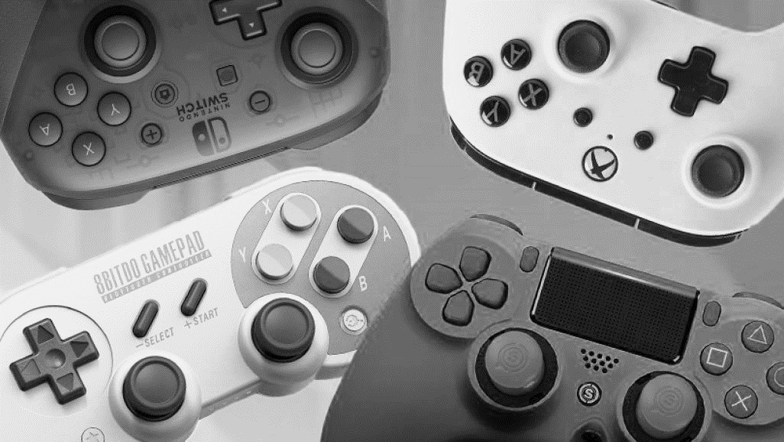
Agenda
Current Expectation
Market Behaviour
Findings
Revised Expectation
Summary
Recommendations

Slide 3
Current Expectation
As per Game Co‘s current understanding, the sales of various geographic regions have stayed the same over the years.

Slide 4
Market Behaviour (1980-2016)
Year 1980- 2000, Market share trend of NA and JP is mirror image of each other. It looks like each market is trying to capture the share of other. During 1992-95 JP sales were highest globally.
Year 1996-2014, NA has highest sales and EU market is steadily growing. But EU has overtook NA market in 2015 and has highest sales globally. JP market has also increased little.

Slide 5
Market is Shifting In 2016, Market share of NA declines by 7 % vs 2015. EU market share gains by 1 % and surpasses NA in 2016. EU is dominating the game market for the first time. Market Share of JP increased by 6%.

Slide 6
Findings
The data suggest that the Game Co’s sales of various geographic regions have changed over the years 1980-2016. Global Sales decline and regional market sales move either upward or downward.
This finding contrasts with our current expectation.

Slide 7
Revised Expectation
The findings challenge our current expectation, so we need to revise our understanding of Game Co‘s business.
Sales of various regional markets is not constant. Infact numbers are declining and observed shift in the markets.
Since 2000, Market share of NA remained highest globally but it is decreasing. However market share of EU is gradually peaking and overtook NA in 2015 and became market leader. JP market grew too.

Slide 8
Summary
Game Co‘s global sales declining and sales of various geographic regions have not stayed the same. Regional market is shifting.
EU market is growing steadily and overtook NA in 2015, captured 39% market share for the first time. JP market has potential for growth again.
NA market is continuosly declining and need to investigate further for the reasons.
EU market looks attractive for the future. Game Co needs to redistribute marketing budget for this region.

Slide 9
Since 2000, Games produced are double than the Games sold. In order to allocate marketing budget efficiently by Region, 1. Focus on popular Genre, 2. Top Publishers, 3. Platforms on which many games are playable and Discontinue the least selling games. EU market is attractive and dominant, need to shift marketing budget to this market. Focus JP because it has potential for the growth.
Recommendations

Slide 10
Genre Popularity by Region in 2016
Target Genres are Action, Shooter, Sports and Role-Playing
Sales from these 4 Genres contribute around 75% of the Global Sales.
Action, Shooter and Sports are top genres in NA & EU.
Role-playing genre is the most dominant in Japan.

Slide 11
Top Publishers
(2006-16)
Increase engagement with Top 25 Publishers, which generates 80% of Global Sales
Redistribute marketing budget for games offered on PS4 & XOne in NA & EU.
3DS & PSV platforms popular in Japan.

